Slide 1

US LHC Accelerator Research Program (LARP)
Eric Prebys, Fermilab
Director, LARP

Slide 2
Disclosure
I stepped down as director of LARP about a year ago and haven’t had a lot of involvement since.
Replaced by Giorgio Apollinari
Giorgio and most of the other LARP people are preparing for the collaboration meeting in Japan next week
I’ve come out of retirement to give this talk.

Slide 3
LARP History
The US LHC Accelerator Research Program (LARP) was formed in 2003 to coordinate US R&D related to the LHC accelerator and injector chain at Fermilab, Brookhaven, and Berkeley
SLAC joined shortly thereafter
Has also had some involvement with Jefferson Lab, Old Dominion University and UT Austin
LARP has contributed to the initial operation of the LHC, but much of the program is focused on future upgrades.
The budget grew, and from ~2008-2012 it was funded at $12-13M/year, divided among.
Accelerator research
Magnet research (~half of program)
Programmatic activities, including support for personnel at CERN
Starting in 2012, we have transformed LARP to a project with hard deliverables.

Slide 4
LARP Contributions to Initial LHC Operation
Schottky detector
Used for non-perturbative tune measurements (+chromaticities, momentum spread and transverse emmitances)
Tune tracking
Implement a PLL with pick-ups and quads to lock LHC tune
Investigating generalization to chromaticity tracking
AC dipole
US AC dipole to drive beam
Measure both linear and non-linear beam optics – Primary tool for high energy optics
Luminosity monitor
High radiation ionization detector integrated with the LHC neutral beam absorber (TAN) at IP 1 and 5.
Synchrotron Light Monitor
Used to passively measure transverse beam size and monitor abort gap
Not a LARP project, but significantly improved by LARP.
Low level RF tools
Leverage SLAC expertise for in situ characterization of RF cavities – Fully integrated
Personnel Programs (more about these shortly)…

Slide 5
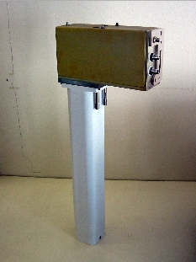
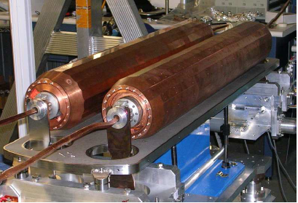
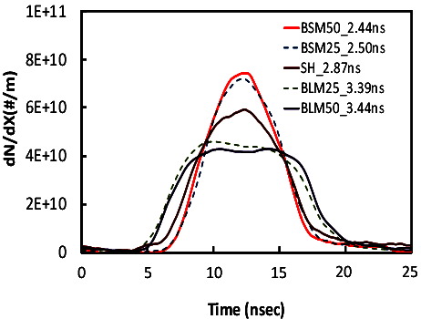
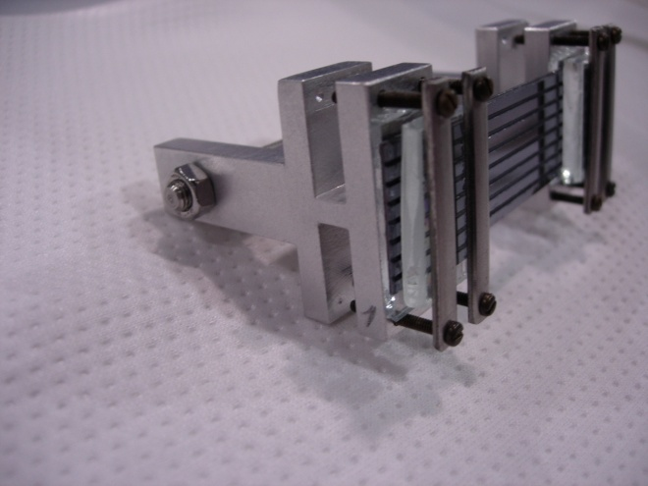
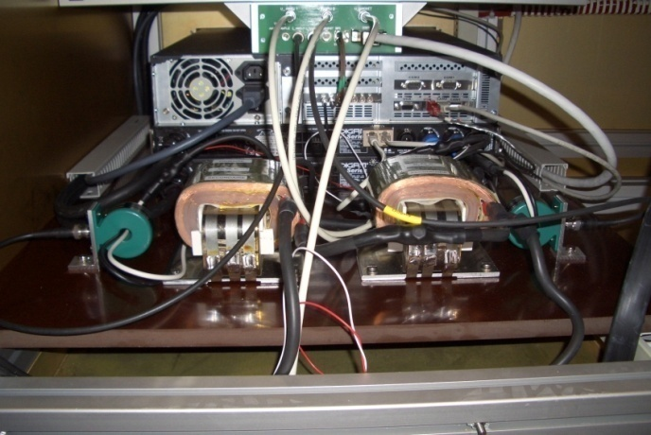
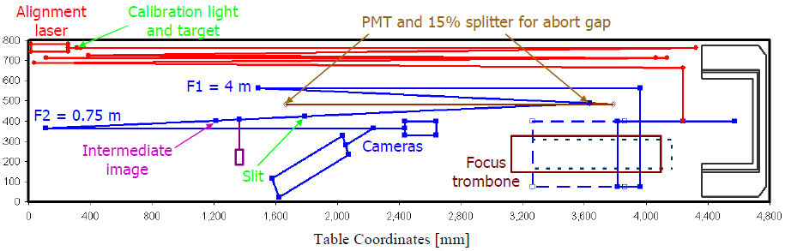
Some Random LARP Activities
Flat Bunches
Luminosity Monitor
Rotatable Collimators
AC Dipole
Crystal Channeling
Instability Modeling
Sync. Light Monitor

Slide 6
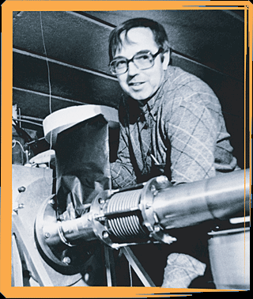
Toohig Fellowship
Named for Tim Toohig, one of the founders of Fermilab. Nursery of talent in Accelerator Technology.
Open to recent PhD’s in accelerator science or HEP to contribute to the LHC at one of the host US Labs (BNL, FNAL, LBL, SLAC).
Past
Helene Felice, LBNL, now staff at LBL
Rama Calaga, BNL, now CERN staff
Ricardo de Maria, BNL, now CERN Fellow
Themis Mastoridis, SLAC, Ass. Prof. at Cal Poly,
SLOC
Ryoichi Miyamoto, BNL, now ESS Staff
Dariusz Bocian, FNAL, now Ass. Prof. at The Henryk Niewodniczański Institute of Nuclear Physics
Valentina Previtali, now Teacher in Geneva
Simon White, BNL Staff
John Cesaratto, SLAC/CERN
Present
Ian Pong, LBNL
Silvia Verdu Andres, BNL
Trey Holik, selected as 2014 Toohig Fellow

Slide 7
New Direction for LARP
LARP had historically been an R&D organization
Not well structured for hard deliverables
CERN upgrade plans in a state of flux
Watershed events
CERN formalized the planning for the luminosity upgrade (HL-LHC/HiLumi-LHC
In June 2012, CERN chose 150 mm as the aperture for the final focus quads
At the DOE’s request, we began the process of transforming LARP into a project to encompass all US contributions to the luminosity upgrade of the LHC.
Budget Guidance
Flat-Flat LARP funding @ ~$12.4M/year through FY16
A total of $200M (then year dollars) TPC, assuming CD-3 at approximately the beginning of FY17
“Some amount” of General Accelerator Research and Development (GAR D) funds invested in support of this program.
Began the process of scope selection in Fall 2012

Slide 8
Context: Long Term LHC Plans
Leveled luminosity of: 5x10³⁴ cm⁻²s⁻¹

Slide 9
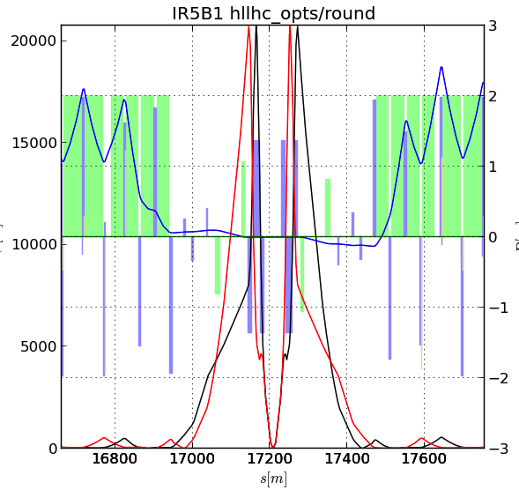
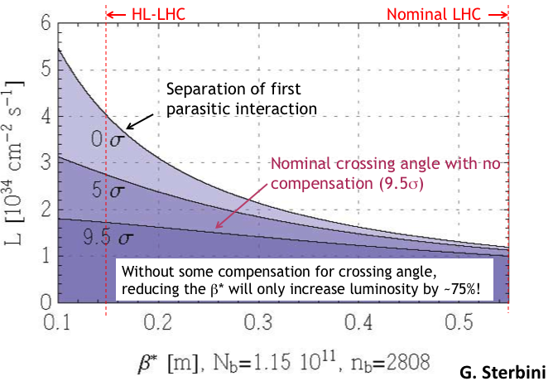
Key Components of HL-LHC
Reduce β* from 55 cm to 15 cm
Requires large aperture final focus quads
Beyond NbTi without making the quads unmanageably long.
➔Requires Nb₃Sn
never before used in an accelerator!
Nb3Sn R&D key component of LARP
BUT, reducing β* increases the effect of crossing angle
“Piwinski Angle”

Slide 10
High Luminosity LHC: The Big Picture
HL-LHC
LARP lives here

Slide 11
Candidate Deliverables Considered
Traditional LARP Scope
150 mm aperture Nb₃Sn quadrupoles
Likely just cold masses, divided between here and CERN
Crab Cavities
Prototypes. Production Units. Cryomodules.
High Bandwidth Feedback System
Pick-ups. Processing Systems. Response Kickers.
Collimation
Rotatable collimators.
Hollow electron beams.
New Scope
11 T Nb₃Sn dipoles
Used to make room for collimation in dispersion suppression region
Has been a bilateral CERN/FNAL effort
Large Aperture NbTi D2 separator magnets
First dual aperture magnets near Irs
Has been bilateral CERN/BNL effort
Selected as primary scope
Still pursued as R&D efforts

Slide 12
Motivation for Nb₃Sn
All superconducting magnets that have ever gone into an accelerator are minor variations on the Tevatron design
NbTi conductor
collared pre-loading
Nb₃Sn can be used to increase aperture/gradient and/or increase heat load margin, relative to NbTi
Very attractive, but no one has ever built accelerator quality magnets out of Nb₃Sn
Whereas NbTi remains pliable in its superconducting state, Nb3Sn must be reacted at high temperature, causing it to become brittle
Wind and react on a mandrel
Increased mechanical stresses exceed the limits of traditional collared pre-loading
New preloading technique developed

Slide 13
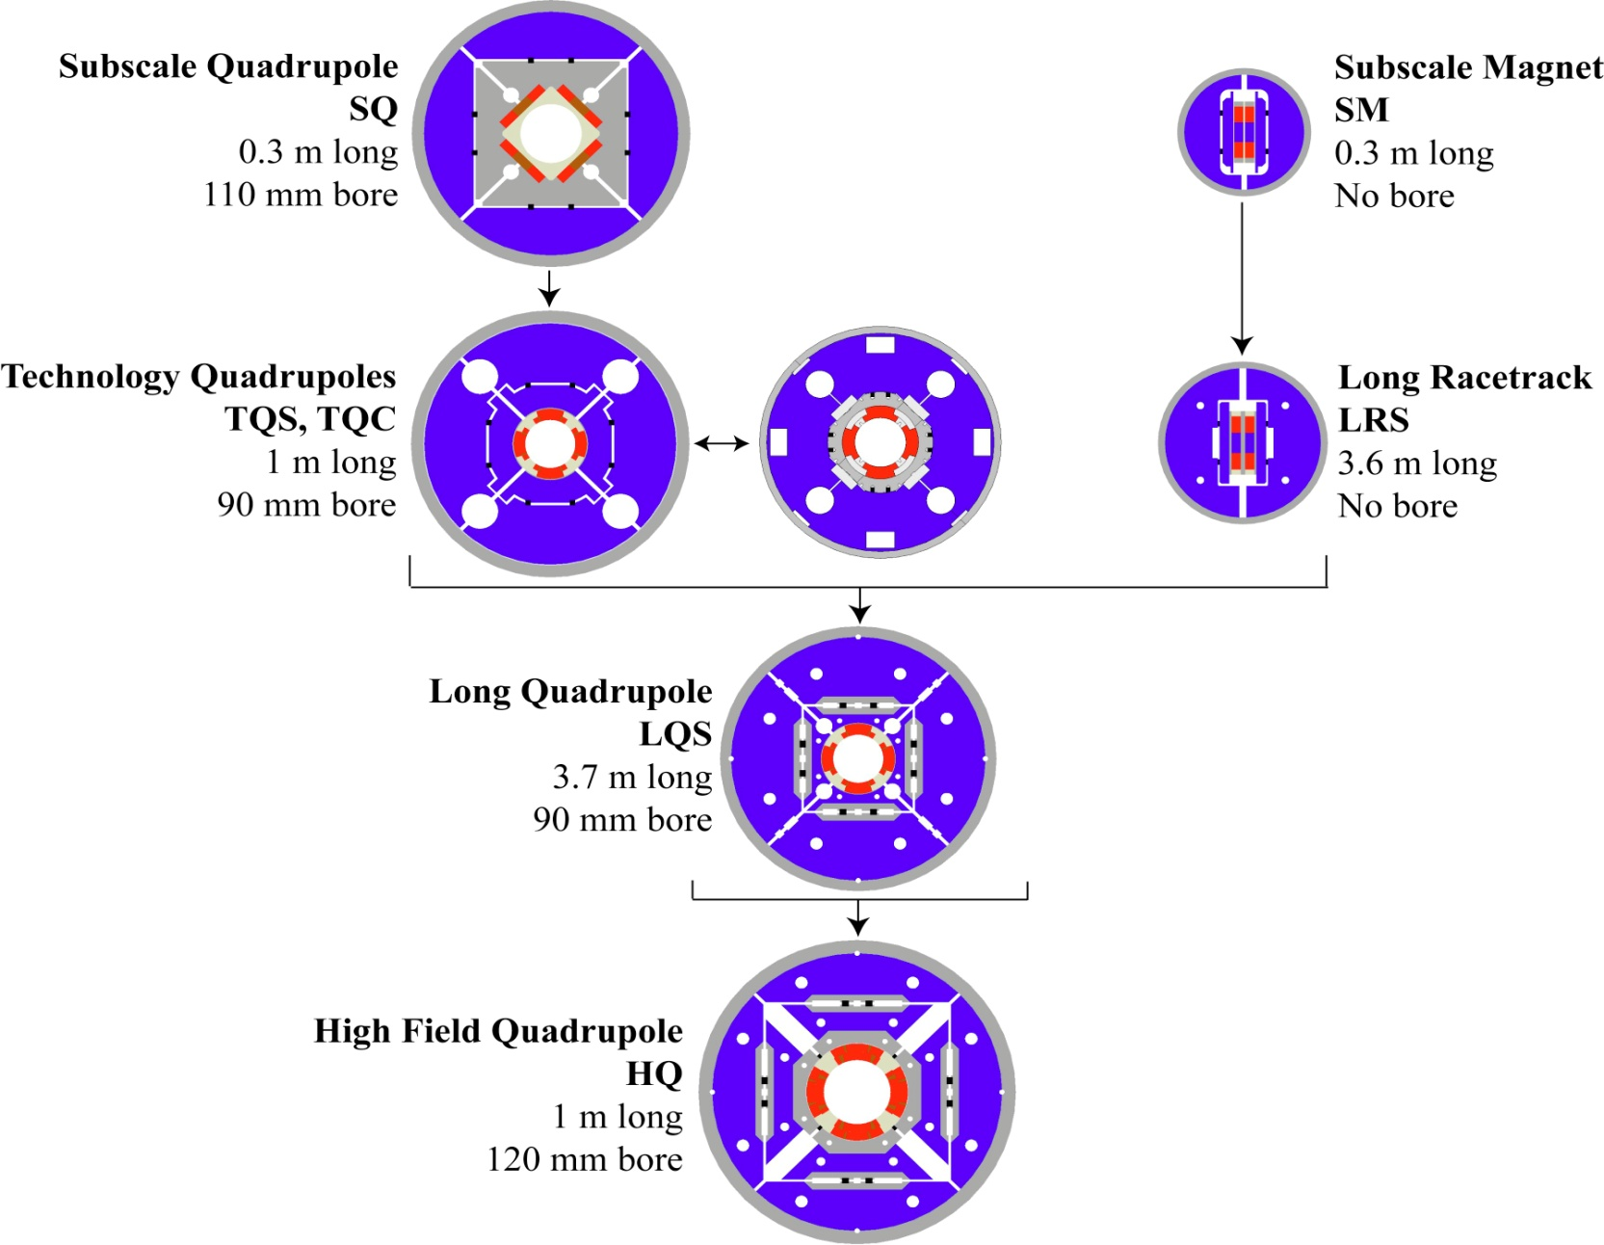
LARP Magnet Development Tree
Completed
Achieved
220 T/m
Length scale-up
High field
Accelerator features
Being tested
Last “LARP only” magnet

Slide 14
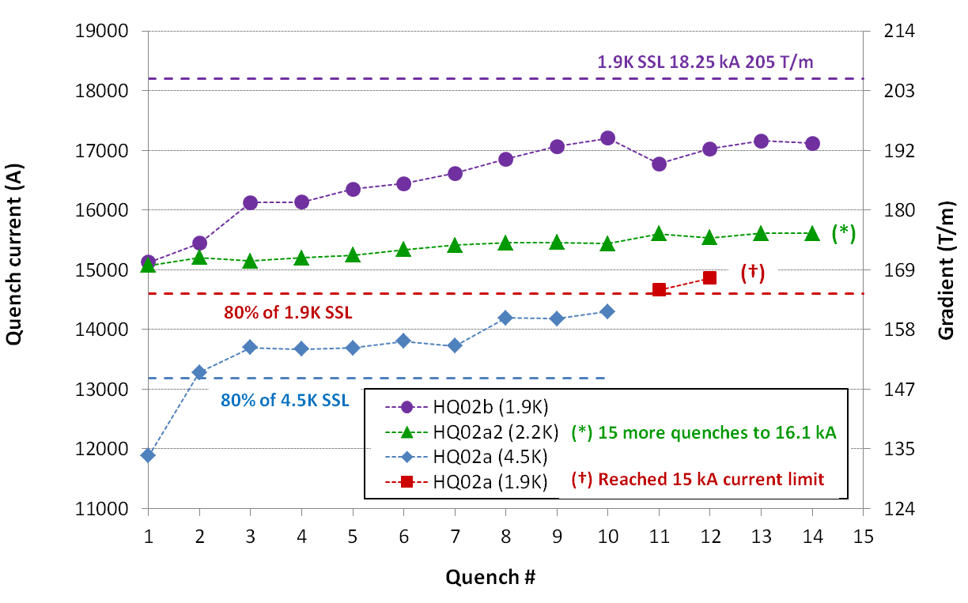
HQ (120 mm) Achievements
Goal to demonstrate all performance requirements for Nb₃Sn IR Quads in the range of interest for HL-LHC (magnetic, mechanical, quench protection etc.)
120 mm aperture, 15 T peak field at 220 T/m (1.9K)
First LARP design incorporating all provisions for accelerator field quality:
Control of geometry, saturation, magnetization, eddy currents
Alignment at all stages of coil fabrication, assembly & powering
Stainless steel core biased toward the thick edge
Dramatic reduction of ramp rate dependence
14.6 kA (80% SSL) up to 150 A/s (1.9K)
Safe discharge up to 300 A/s
Partial core coverage to control eddy currents while maintaining current sharing

Slide 15
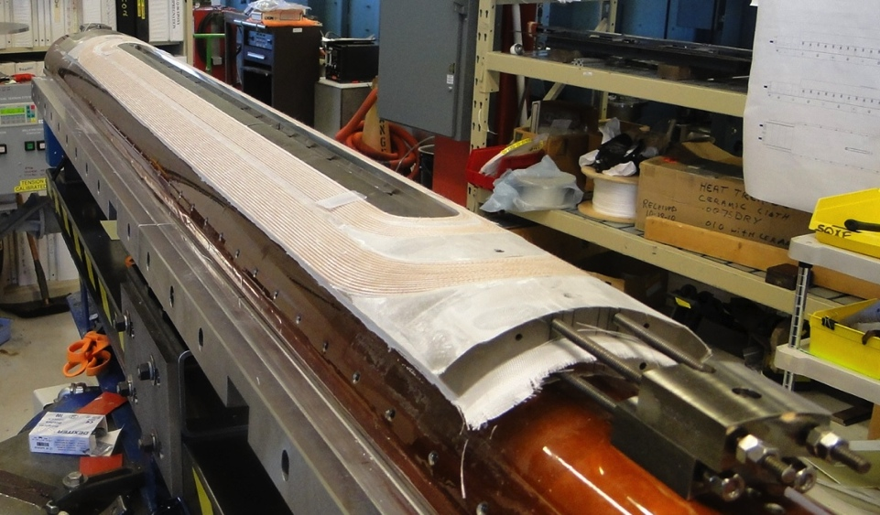
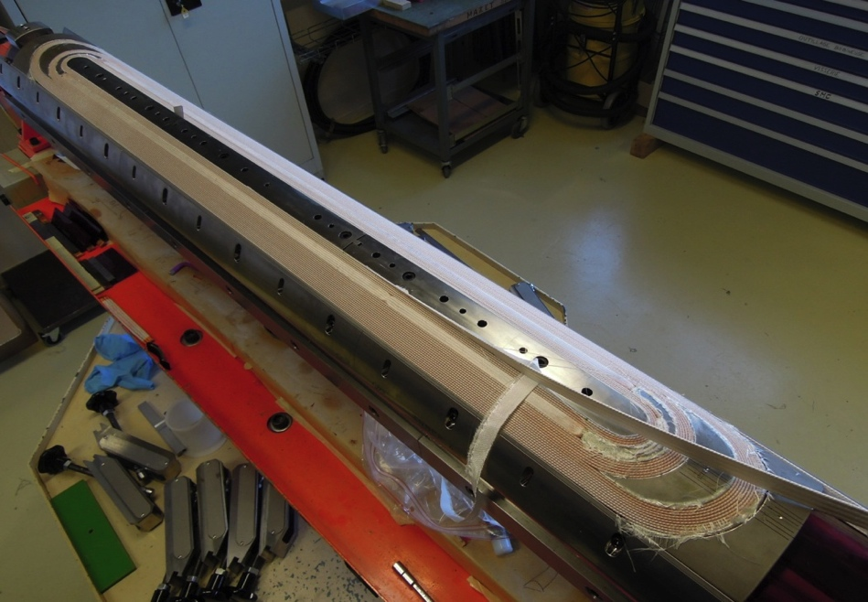
QXF (150 mm HL-LHC Quads) Plans
First genuine prototype:
Joint project between LARP and CERN!
Short model program: 2014-2016
First SQXF coil test (Mirror struct.) in Dec. 2014
First magnet test (SQXF1) in May 2015
2 (LARP) + 3 (CERN) short models + reassembly (~4)
Long model program: 2015-2018
Coil winding starts in 2015: Jan. (LARP)
First LQXF coil test (Mirror structure) in Dec. 2015
First model test in Oct. 2016 (LARP) and July 2017 (CERN)
3 (LARP) + 2 (CERN) models in total
Series production: 2018-2022
LARP
CERN

Slide 16
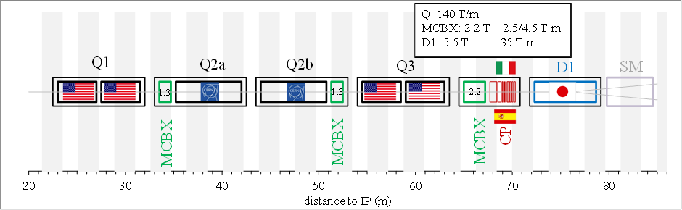
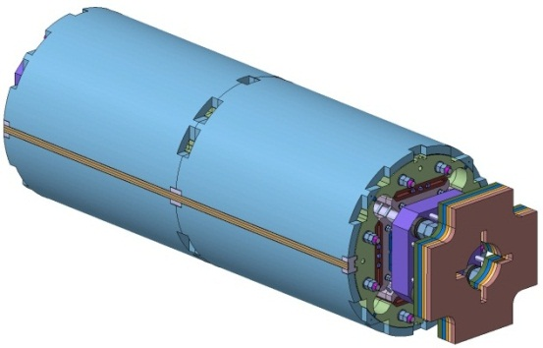
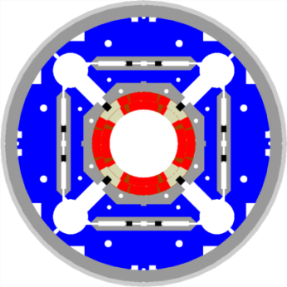
HL-LHC US Magnet Contributions
Q1 and Q3 Nb3Sn Magnets
Preferred US Scope: Q1 and Q3 Cold Mass Assembly (x10)
Includes two ~ 4.5m long Nb3Sn magnets installed in a SS helium vessel with end domes, ready for insertion into a cryostat
Minimum US Scope: Component Magnets for Q1 and Q3 (x20)
CERN responsible for assembling the Q1 and Q3 cold mass
Decision depends on TPC and project funding level
CERN’s Scope: Install Q1 and Q3 Cold Mass Assemblies into CERN-provided cryostats, final test, tunnel installation, commissioning, etc.
MQXF

Slide 17
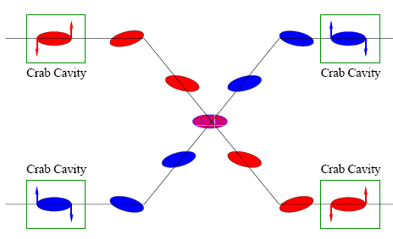
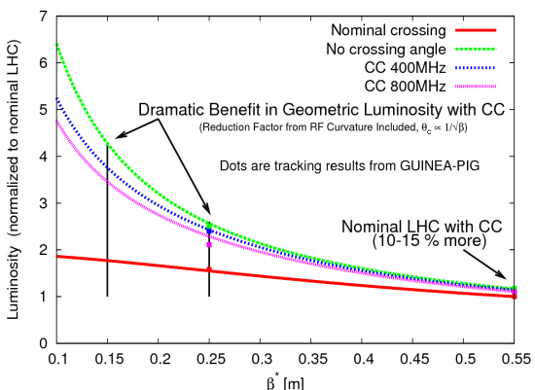
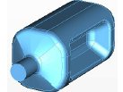
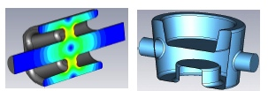
Crab Cavities
Technical Challenges
Crab cavities have only barely been shown to work.
Never in hadron machines
LHC bunch length ➔ low frequency (400 MHz)
19.4 cm beam separation ➔ “compact” (exotic) design
Additional benefit
Crab cavities can aid in leveling!
Currently aiming for:
SPS test in 2016
UK
LARP

Slide 18
Crab Kissing Scheme
Using crab cavities to level luminosity and lower peak interaction density

Slide 19
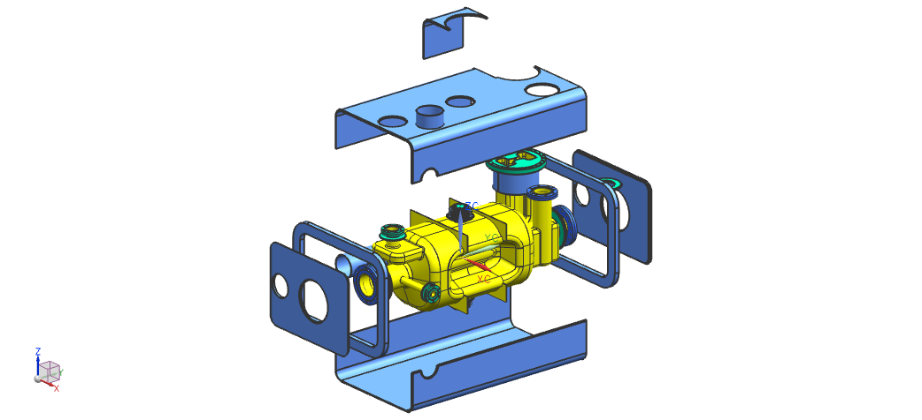
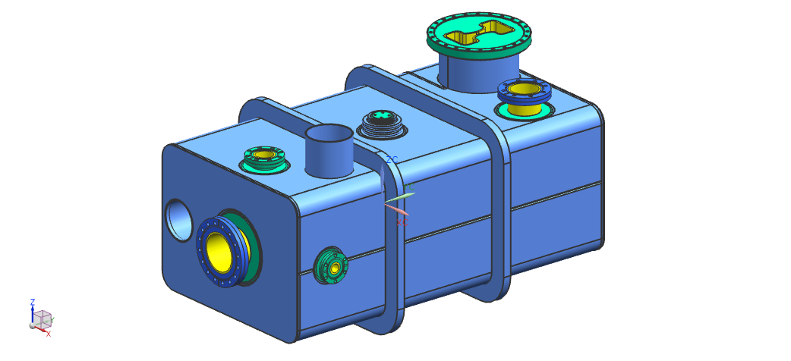
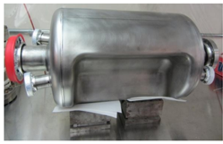
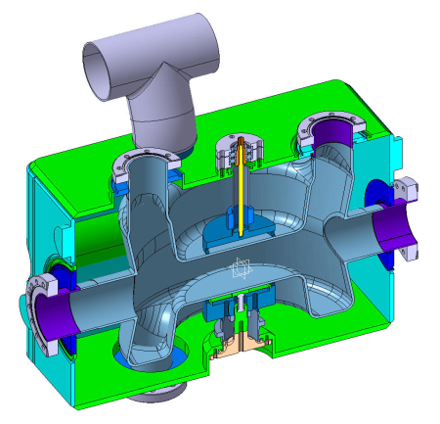
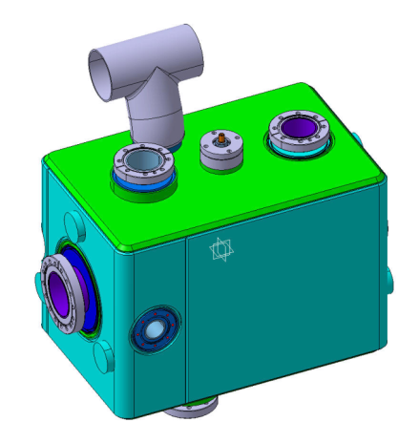
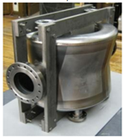
US Crab Cavity Contribution
Crab Cavities
US Scope: 40 “dressed” crab cavities
Components such as tuners, HOM couplers, etc. under discussion
CERN Scope: Cryomodules
Integrate and install dressed cavities into ten Cryomodules (four cavities each) and install in tunnel. (includes two spares)
SPS Demonstration planned as part of LARP
Two cryomodules, two dressed cavities each (LARP expected to deliver dressed cavities)
Two design options under consideration (RF Dipole and Double Quarter Wave)
RFD Option
DQW Option

Slide 20
High Bandwidth Feedback System
The high bandwidth feedback system is a GHz bandwidth instability control system
Increases LHC luminosity via higher SPS currents
Improves LHC beam quality and allows SPS operational flexibility
Leverages US expertise from e+e- @ SLAC
LARP continues technology R&D & development of novel control methods
Test of full functionality prototype in SPS by FY15-FY16
Aiming for a deliverable (within LARP) of an SPS full-function instability control processing system hardware, firmware and diagnostic for use at SPS post LS2. Presently not planned as baseline HL-LHC or LIU
CERN to contribute beam-line components (kickers, cable plant, etc.)
BPM
Active closed loop
Feedback
Kicker
Beam
Analog
Front
End
ADC
Signal
Processing
DAC
Analog Back
End
Power Amp
transverse
position
pre-processed
sampled
position
“slices”
calculated
correction data
correction
signal
pre-distortion
drive signal

Slide 21
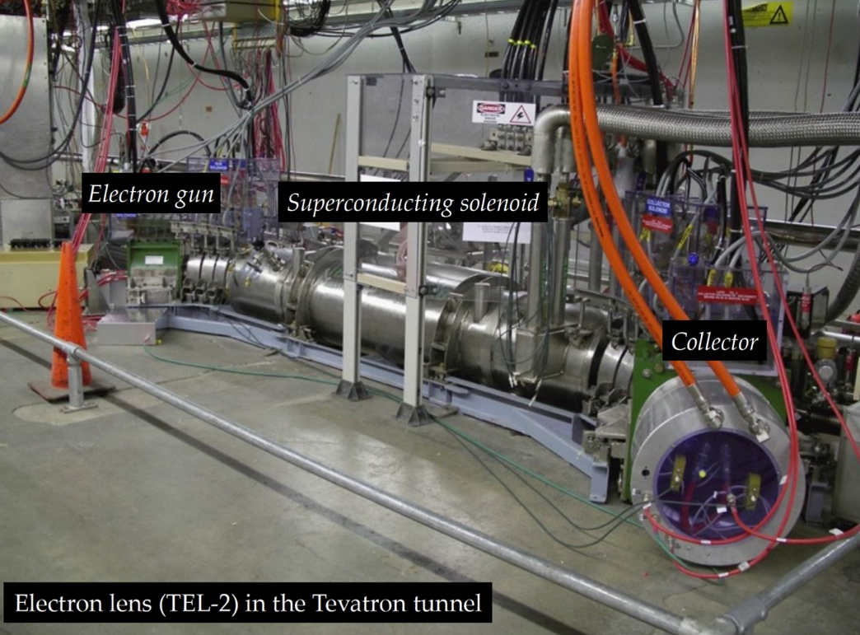
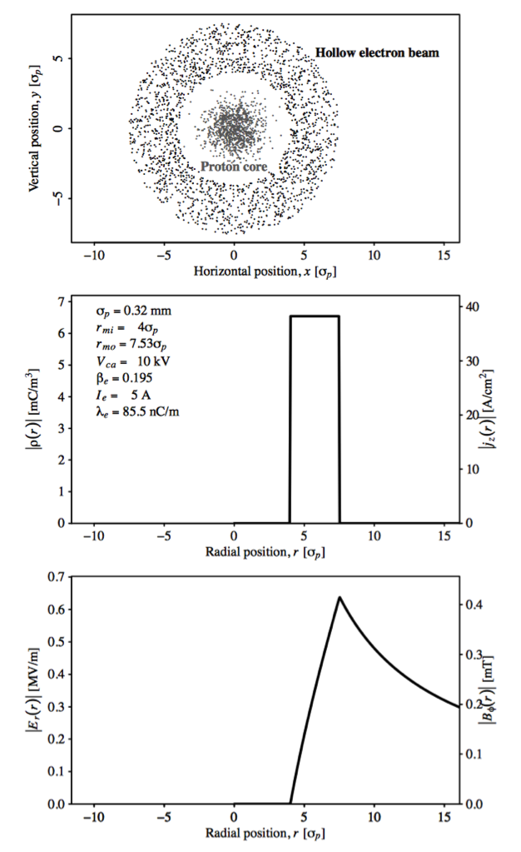
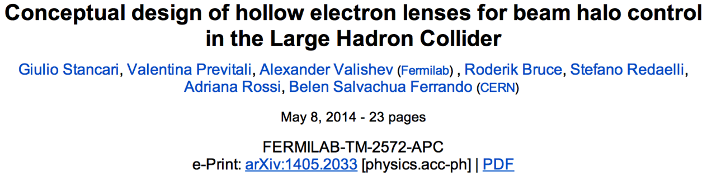
e-hollow lens & beam-beam simulation
Beam-Beam Simulation (FNAL and LBL)
Bench-marking with US simulation/experience for beam-beam computations performed at CERN
Assess new HL-LHC elements (large angles, CC, etc) and study all possible alternative schemes to achieve ultimate luminosity

Slide 22
(L)ARP2
Several activities presently supported by LARP will not find space once the US-HL-LHC Project starts according to DOE order 413.3b
Toohig Fellowship
R&D Studies (WBFS, e-hollow lens as of today) or “soft deliverables” activities (beam-beam simulations or energy deposit calculations)
Accelerator physicist Long Term Visitor program to LHC/HL-LHC
Flavor change from “Transfer of experience from TeV to LHC” (~2010) to “Active Participation in World-wide Accelerator Operations Effort” (~2020)
Need for (L)ARP2 from ~2018 onward at level of few (~3-4) M$ exclusive of HFM development for HE-LHC or VLHC/FCC/SppC

Slide 23
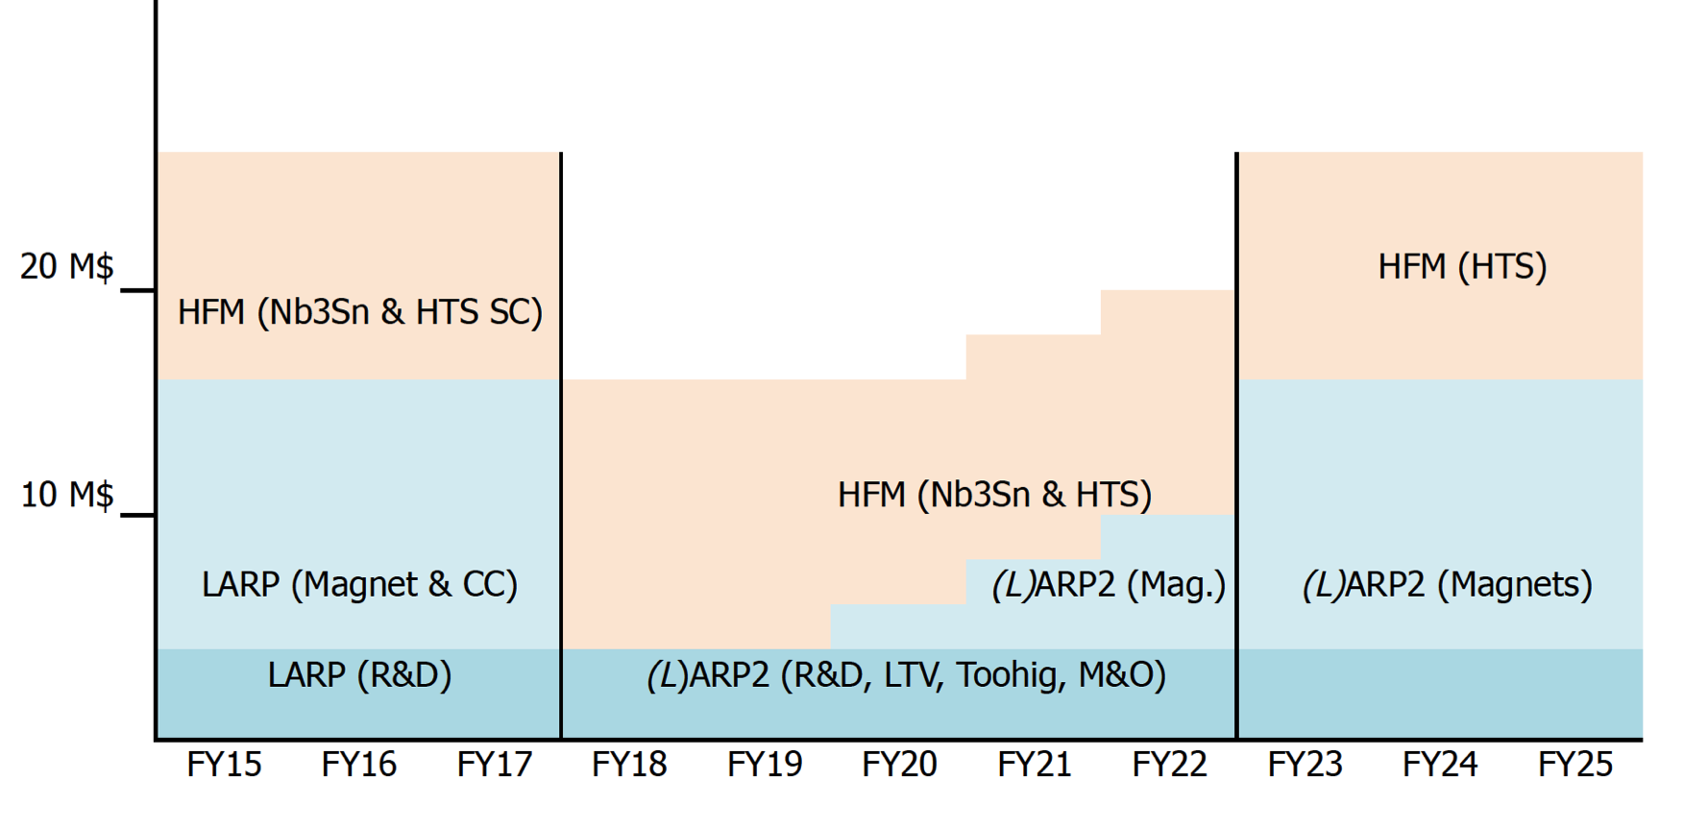
Possible High Level Scenarios HFM+(L)ARP2+US-HL-LHC
ARD Effort on Magnets and LHC/”Future C” R&D
HFM @ 12M$
(L)ARP2 @ 4 M$
US-HL-LHC Project
 | FY15 | FY16 | FY17 | FY18 | FY19 | FY20 | FY21 | FY22 | FY23 | PROJECT TOTAL
LLI (pre-Project funding) |  | $10M | $23M |  |  |  |  |  |  | $33M
Project funding (MIE) |  |  |  | $34M | $51M | $43M | $31M | $17M | $6M | $182M
TOTAL |  | $10M | $23M | $34M | $51M | $43M | $31M | $17M | $6M | $215M

Slide 24
Conclusions
LARP has been an effective organization for coordinating US activities on the LHC.
We have successfully transitioned into a project to produced deliverables required by the luminosity upgrade.

